Slide 1

CAPSTON PROJECT FINA 2015
SEYEDPOURIA MODARESI

Slide 2
APPROACH
DATA COLLECTION
DATA CLEANING
EXPLORATORY DATA ANALYSIS
HYPOTHESIS TEST
REGRESSION ANALYSIS

Slide 3
DATASET AND DEFINATIONS
2015 FINA World Championships
Source: OMEGA, official timekeepers of the World Championships
Format: Converted from XML to CSV format
POOL : 50M LONG,10 LANES
STROKES: Freestyle,Breaststroke,Butterfly,Backstrok
ROUNDS HEATS,SEMI,FINAL

Slide 4
MAIN QUESTIONS
Did the swimmers swim faster in final competition?
Did lanes effect on swimmers performance?
How does the performance of swimmers decline over long events?
Does any differences between men and women in performance?
Is there any significant differences between different countries swimmer performance?
What is the relation between reaction time and performance?
Which stroke was the most exciting one?

Slide 5
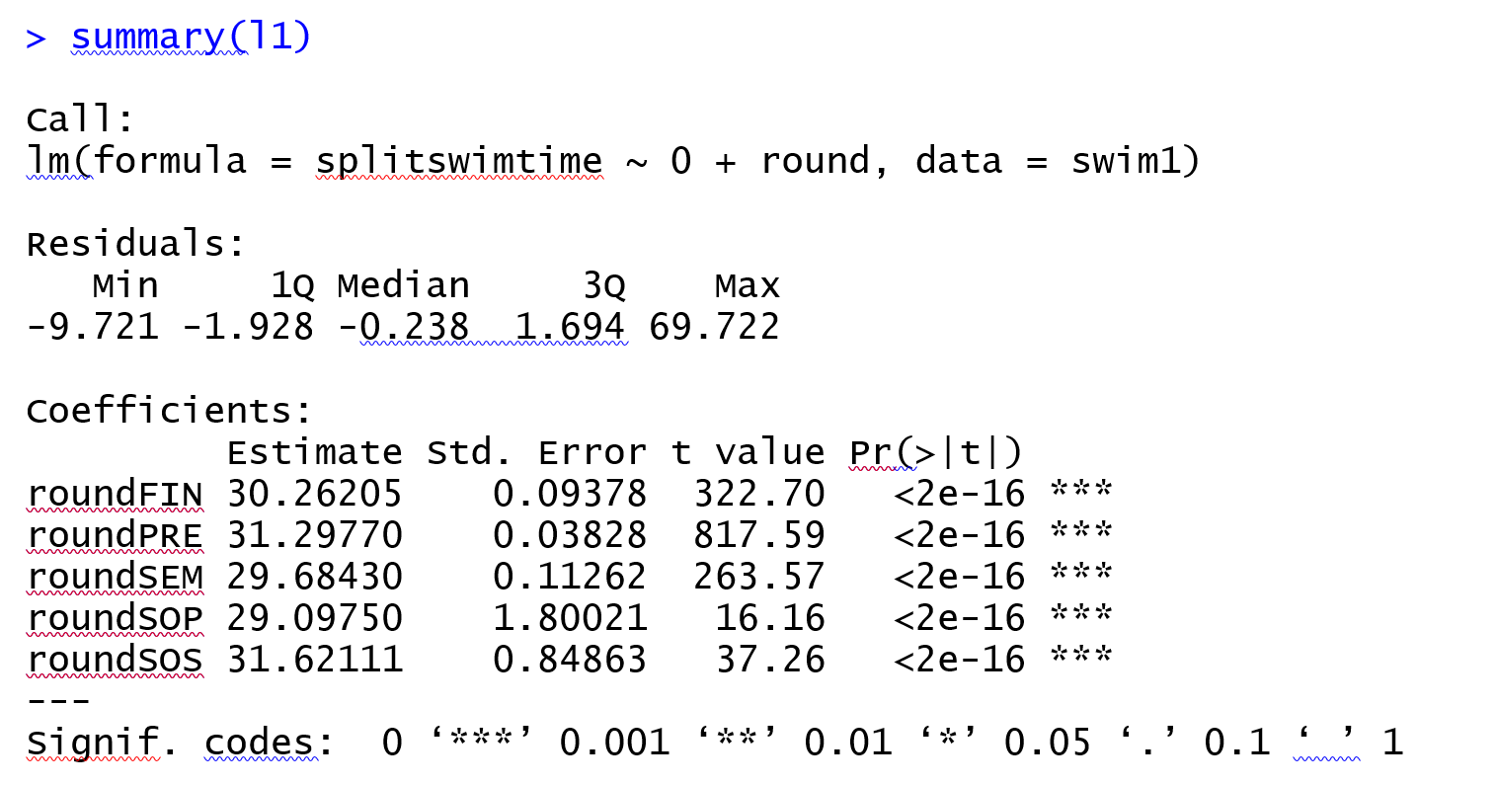
RESULT&CONCLUSION
Did the swimmers swim faster in final or semi final competition?
P-value is less than 0.05 and this shows that the difference in different round is significant

Slide 6
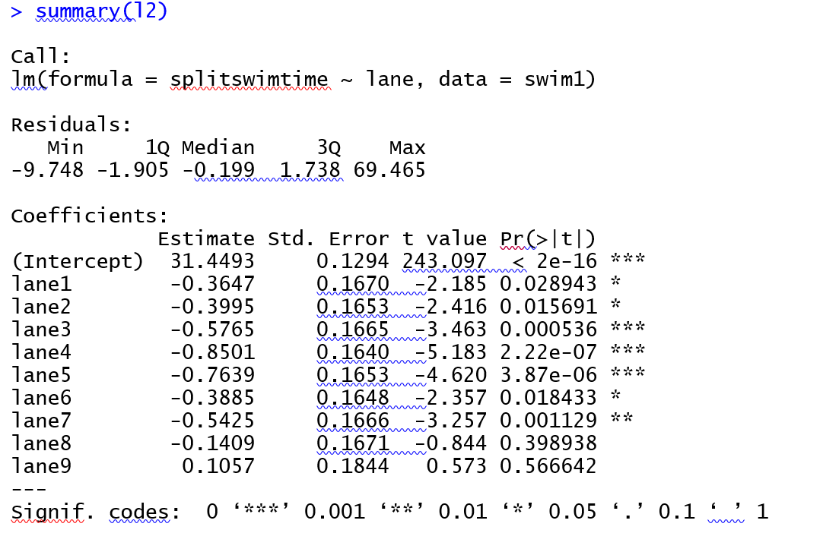
RESULT&CONCLUSION
Did lanes effect on swimmers performance?
As it is clear the p-value is less than 0.05 and as a result it shows that Lane effect Swimmer Performance.

Slide 7
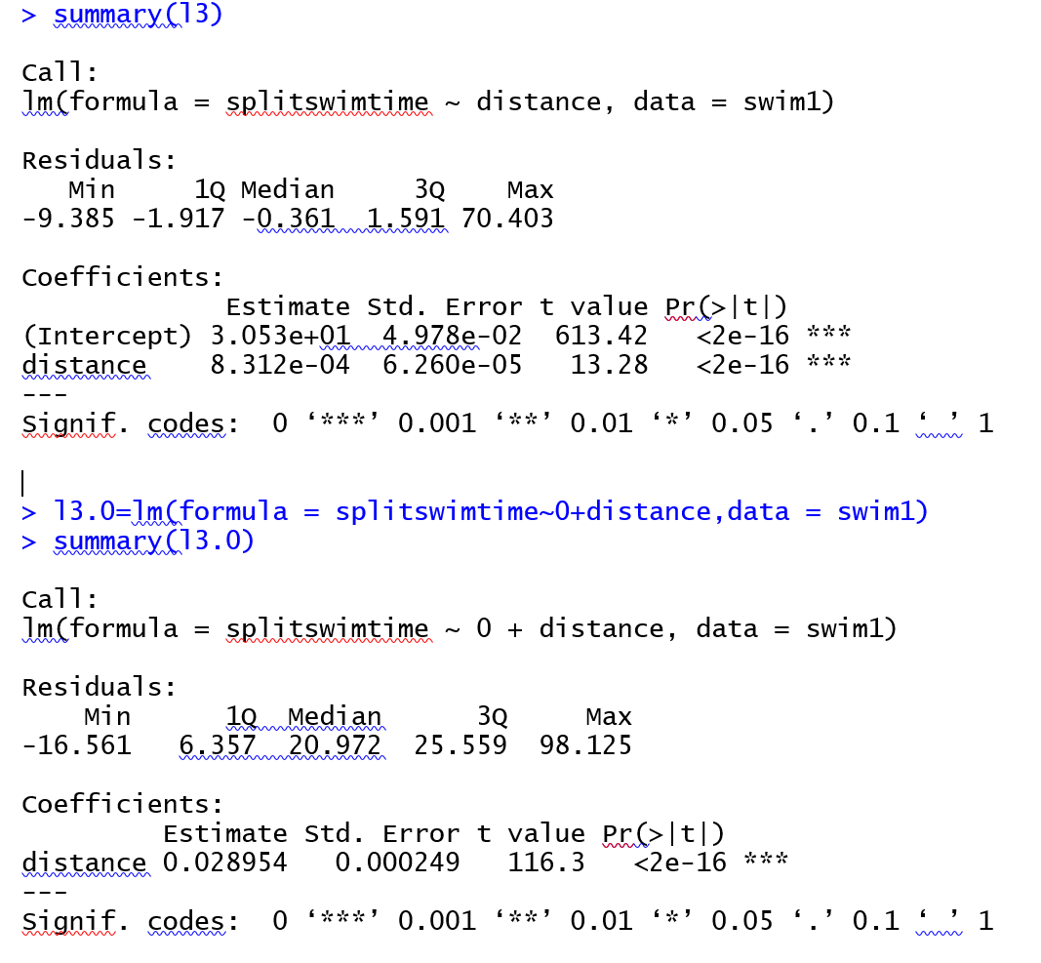
RESULT&CONCLUSION
How does the performance of swimmers decline over long events?
Both models are acceptable due to their p-value is less than 0.05 but model without intercept is much better because its adjusted R-square is much better. So we report that as the event gets longer, the split swimming time increase about 0.03 times, in other words, performance decline by the rate on 3% of its length.

Slide 8
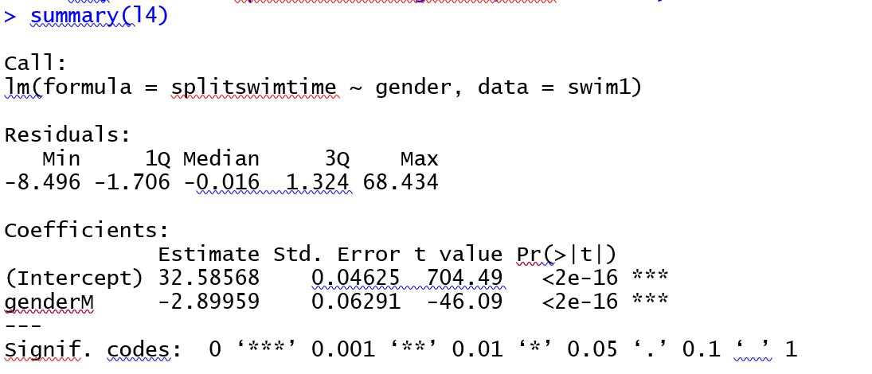
RESULT&CONCLUSION
Does any differences between men and women in performance?
As is clear, significant differences detected between men and women and men perform better in this event.

Slide 9
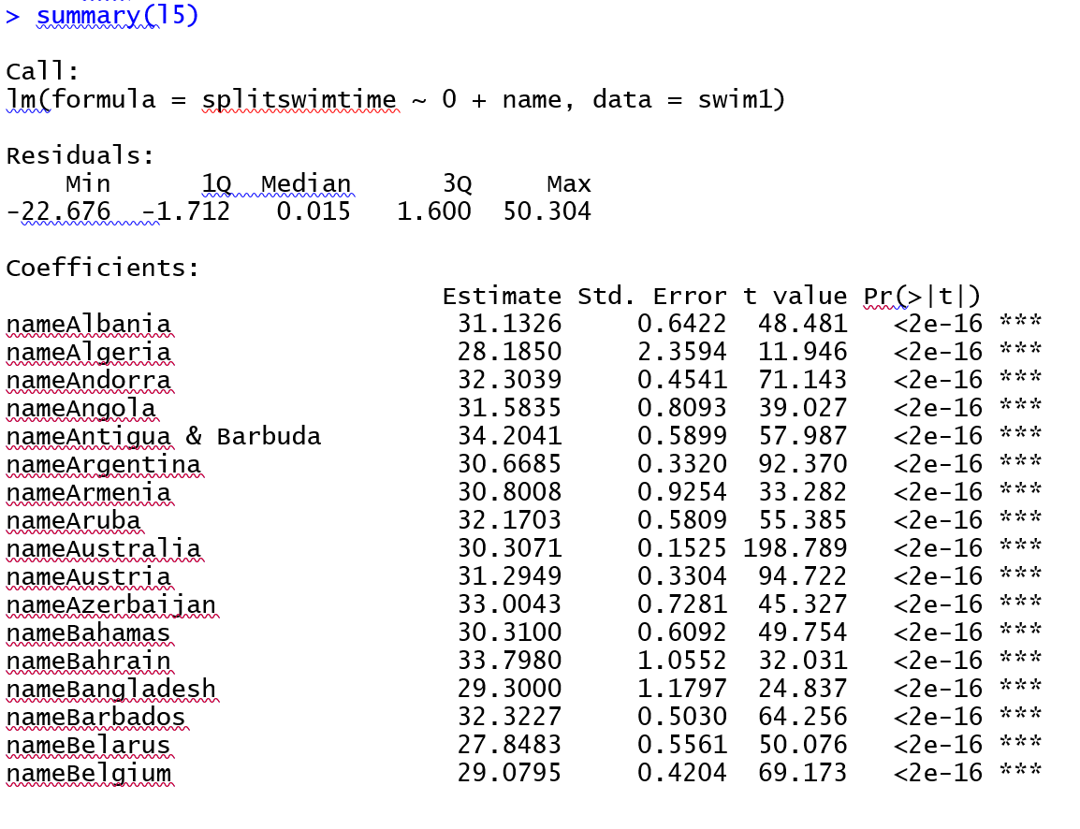
RESULT&CONCLUSION
Is there any significant differences between different countries swimmer performance?
As p-value is less than 0.05, different countries' swimmers perform different than others.(USA had best performance)

Slide 10
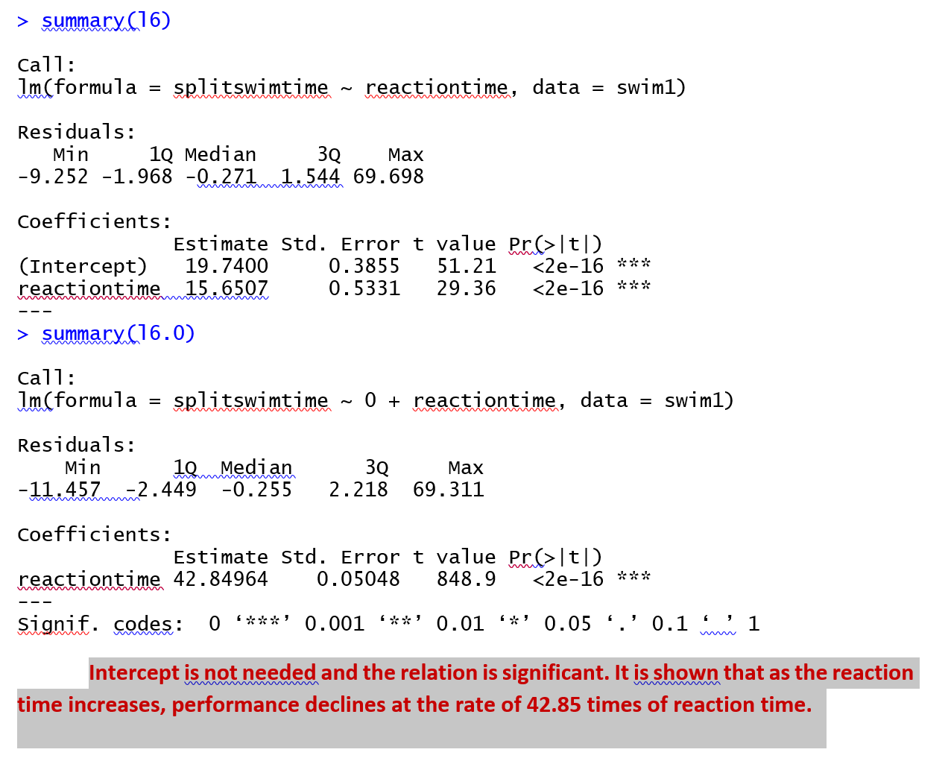
RESULT&CONCLUSION
What is the relation between reaction time and performance?

Slide 11
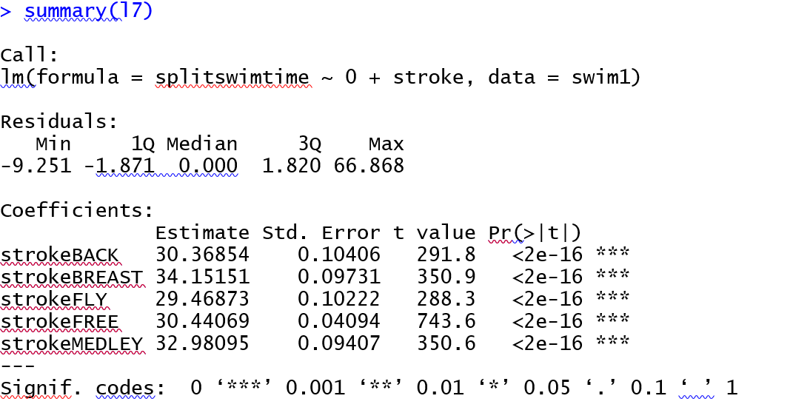
RESULT&CONCLUSION
Which stroke was the most exciting one?
It is shown that fly stroke was the most exciting one in this event

Slide 12

QUESTIONS?

